Slide 1


Optimization Algorithms
L4: Informed Search Algorithms
Alaa Khamis, Ph.D
AI and Smart Mobility Professor at KFUPM and Ex- GM Technical Leader
This lecture is based on Part-I Deterministic Search Algorithms of the textbook: Optimization Algorithms: AI techniques for design, planning, and control problems, Manning Publication, 2024.
2025 © Dr. Alaa Khamis

Slide 2
Outline
Informed Graph Search
MST Algorithms
Shortest Path Algorithms
Notes:
2

Slide 3
Outline
Informed Graph Search
MST Algorithms
Shortest Path Algorithms
Notes:
3

Slide 4
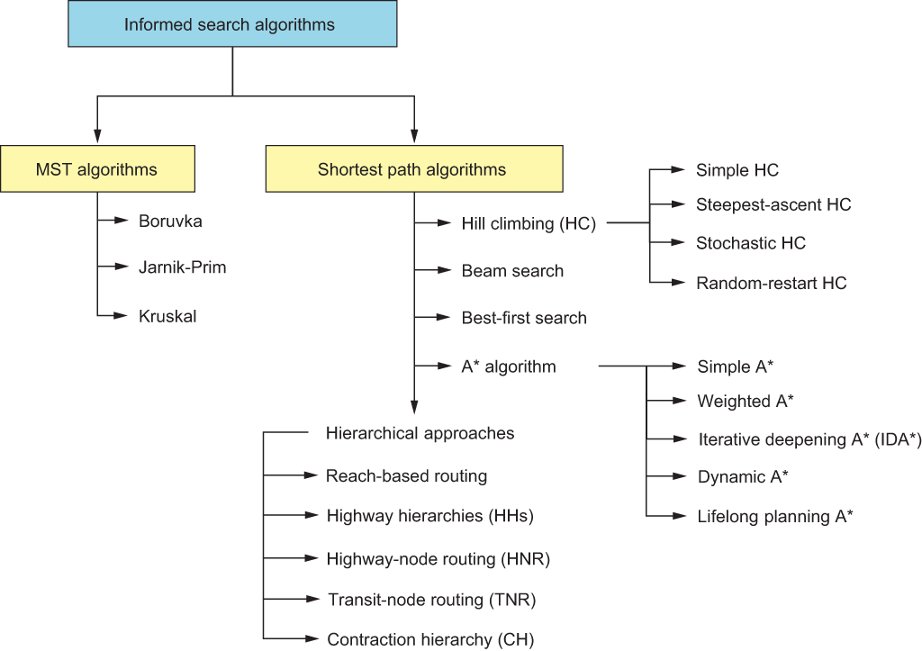
Informed Graph Search
Notes:
4

Slide 5
Outline
Informed Graph Search
MST Algorithms
Shortest Path Algorithms
Notes:
5

Slide 6
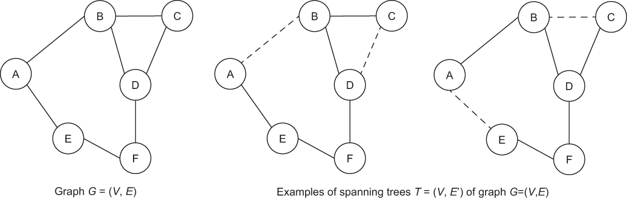
MST Algorithms
Spanning Tree
If G = (V, E) is a graph, then any subgraph of G that:
contains all vertices V of G and
is a tree
is a spanning tree of G.
Notes:
6

Slide 7
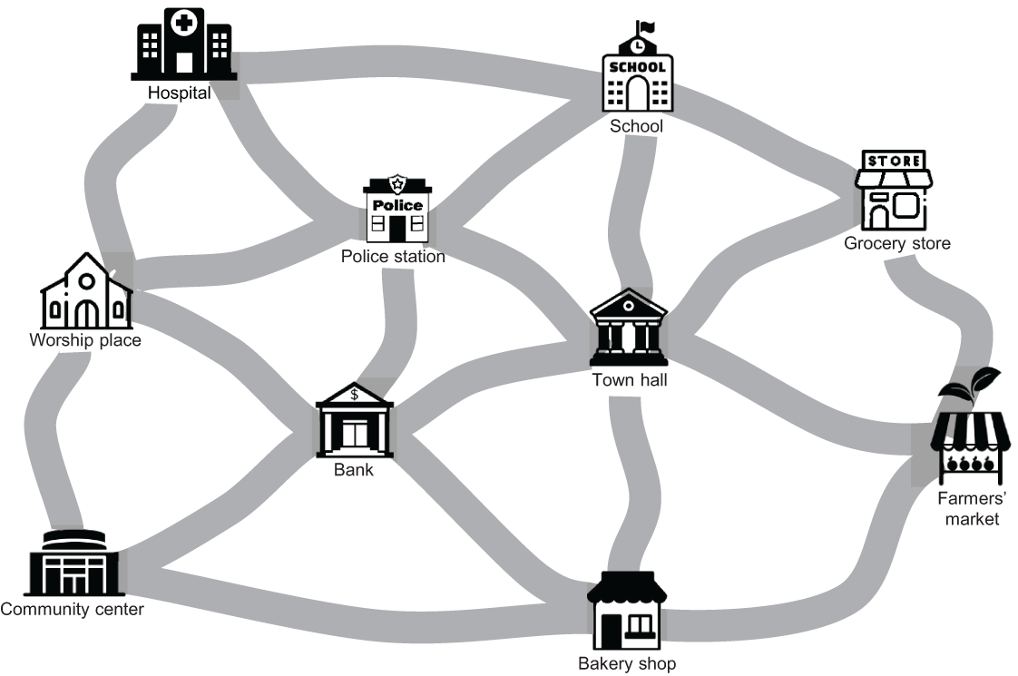
MST Algorithms
Muddy city problem
Muddy city problem

Slide 8
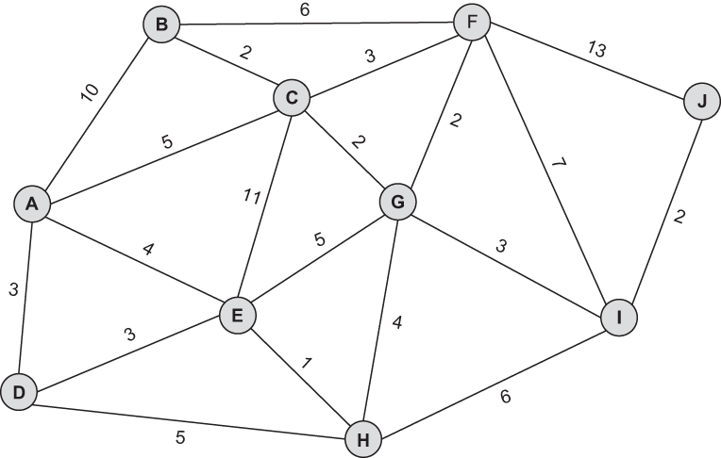
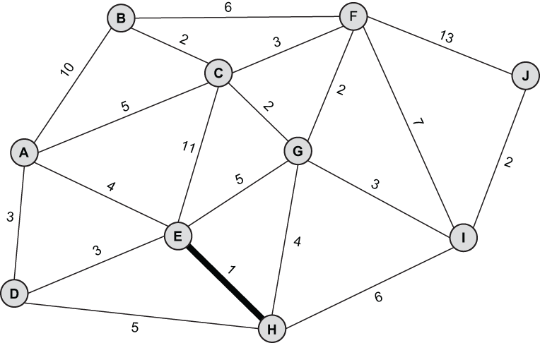
MST Algorithms
Muddy city problem: Kruskal’s Algorithm

Slide 9
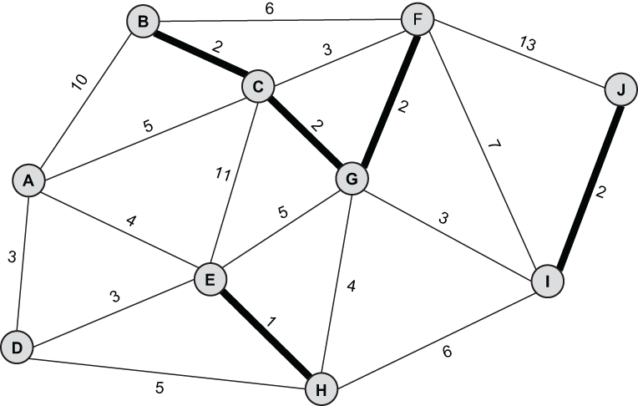
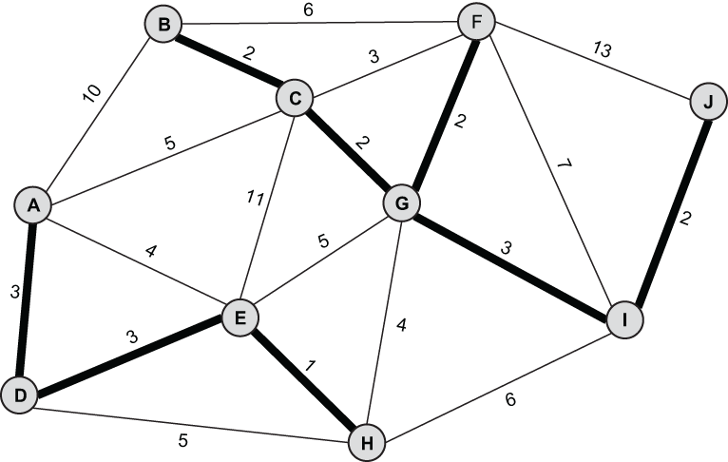
MST Algorithms
Muddy city problem: Kruskal’s Algorithm

Slide 10
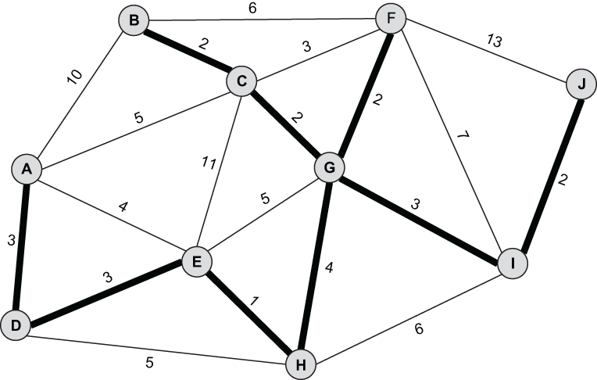
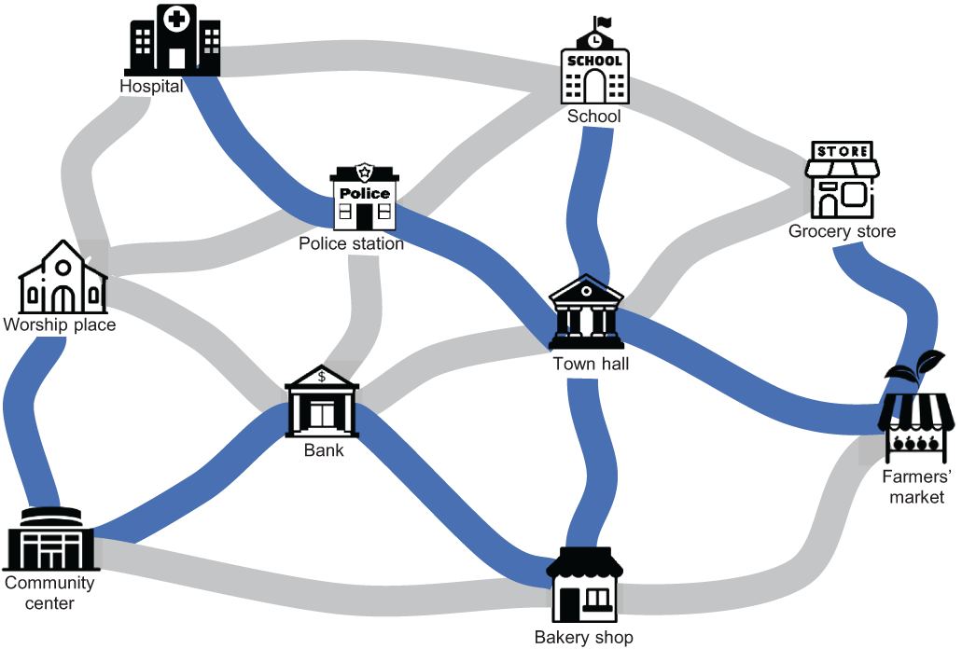
MST Algorithms
Muddy city problem: Kruskal’s Algorithm

Slide 11
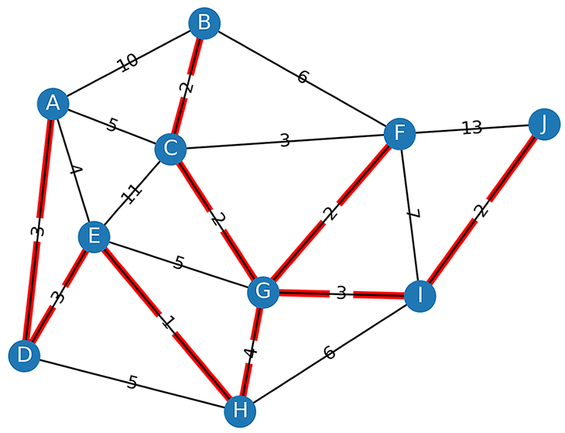
MST Algorithms
Muddy city problem: Kruskal’s Algorithm
Code: https://github.com/Optimization-Algorithms-Book/Code-Listings/blob/main/Chapter%204/Listing%204.1_Kruskal.ipynb

Slide 12
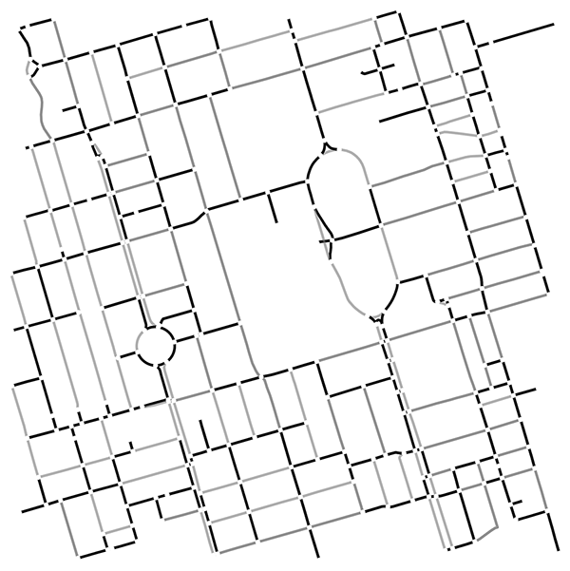
MST Algorithms
UofT MST: Kruskal’s Algorithm
Code: https://github.com/Optimization-Algorithms-Book/Code-Listings/blob/main/Chapter%204/Listing%204.2_MST_UofT.ipynb

Slide 13
Outline
Informed Graph Search
MST Algorithms
Shortest Path Algorithms
Notes:
13

Slide 14
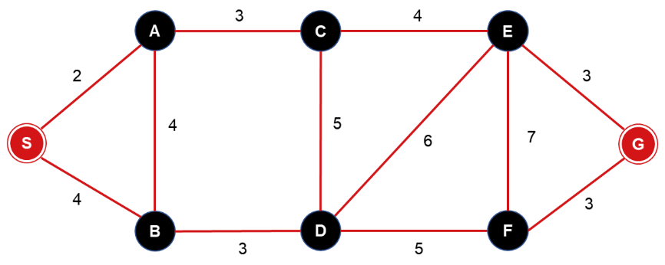
Shortest Path Algorithms
Informed search tries to use the knowledge known about the problem (domain-specific knowledge) to prune the search.
This knowledge is used in the form of a heuristic function.
Example:
8.5
5.7
2.8
10.5
0
10.3
7
3

Slide 15
Shortest Path Algorithms
Best-first
Hill climbing (also known as gradient ascent or gradient descent)
Beam search
A*
Bi-directional A*
Contraction hierarchies (CH)

Slide 16
Shortest Path Algorithms
Best-first
It is a kind or mixed depth and breadth first search.
Adds the successors of a node to the expand list.
All nodes on the list are sorted according to the heuristic values.
Expand most desirable unexpanded node.
Special Case: hill climbing, beam search, A*.

Slide 17
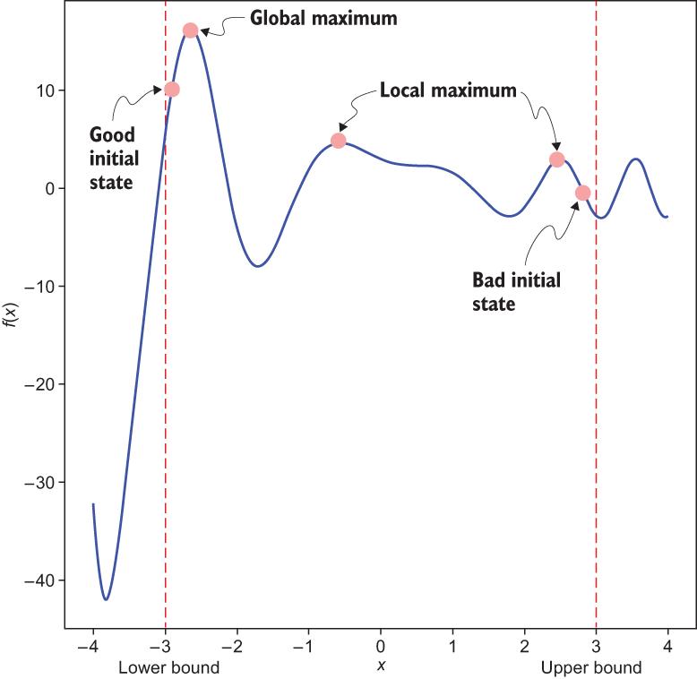
Shortest Path Algorithms
Hill Climbing
In the hill climbing algorithm (also known as gradient ascent or gradient descent) the idea is to keep improving current state, and stop when we can’t improve any more.

Slide 18
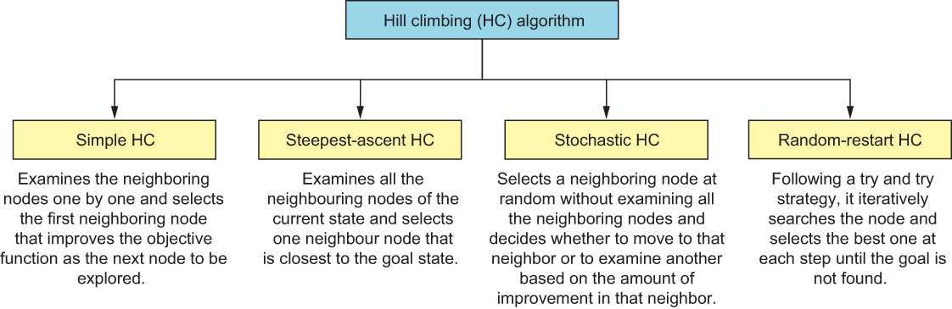
Shortest Path Algorithms
Hill Climbing

Slide 19
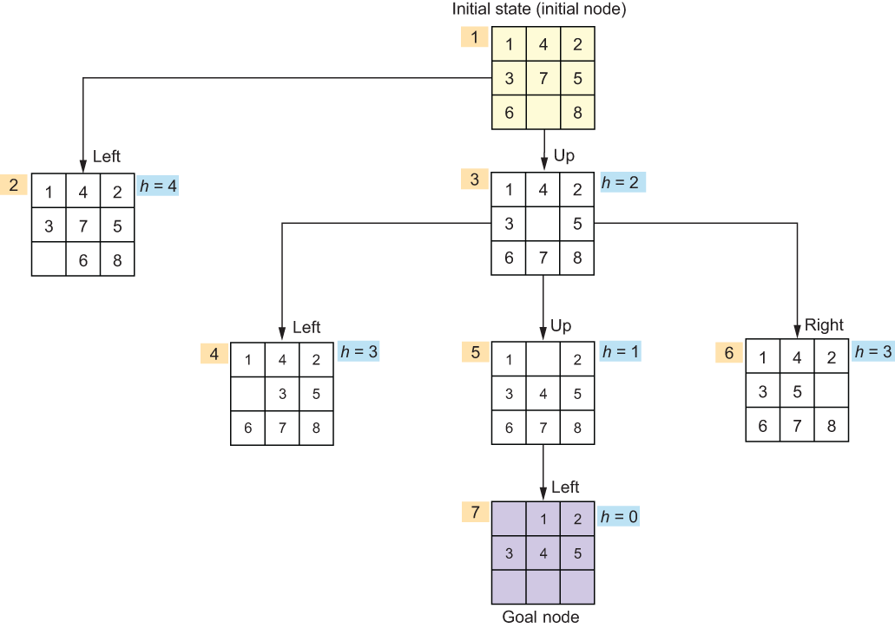
Shortest Path Algorithms
Hill Climbing: 8-Puzzle Problem
Heuristic used is the number of misplaced tails, which has to be 0.
6
7
8

Slide 20
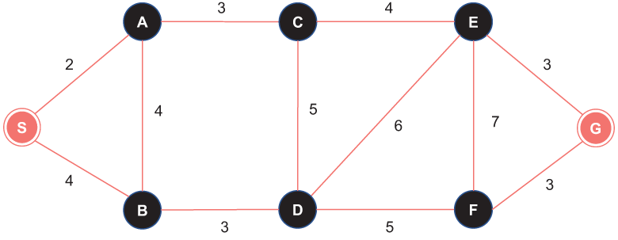
Shortest Path Algorithms
Hill Climbing: 8-Points of Interest (POIs) Problem

Slide 21
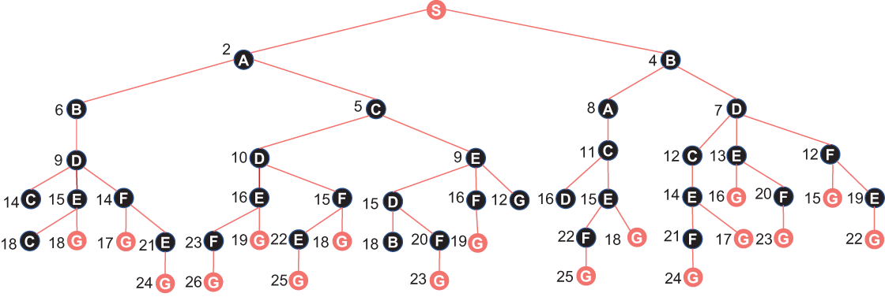
Shortest Path Algorithms
Hill Climbing: 8-Points of Interest (POIs) Problem
From graph to tree

Slide 22
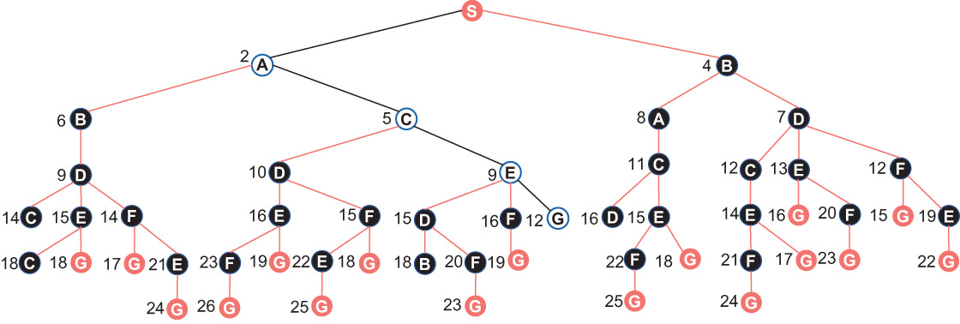
Shortest Path Algorithms
Hill Climbing: 8-Points of Interest (POIs) Problem
Shortest path between S and G using the hill climbing algorithm

Slide 23
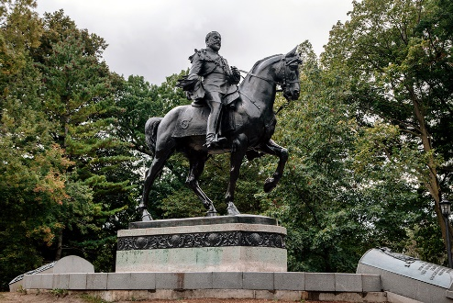
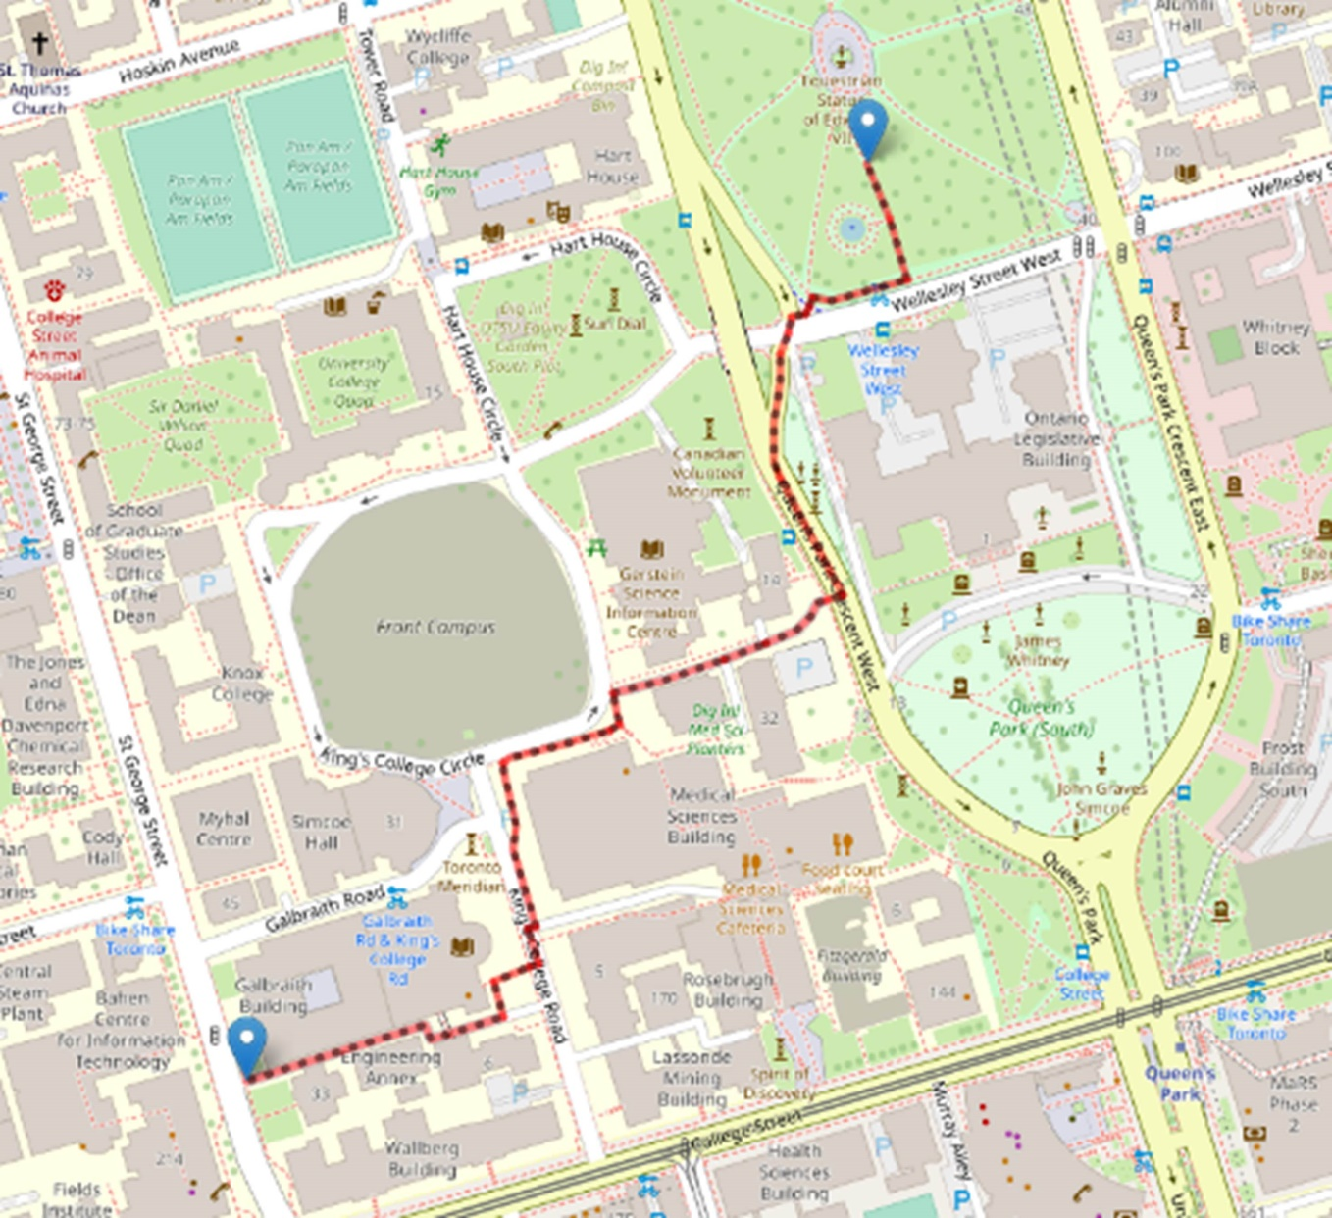
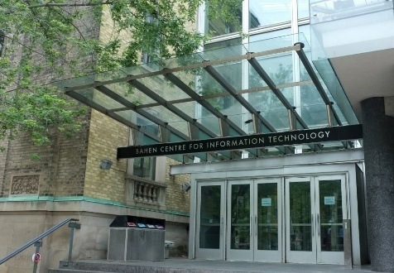
Shortest Path Algorithms
Hill Climbing: UofT Routing Problem
source_point = (43.664527, -79.392442)
# King Edward VII Equestrian Statue
destination_point = (43.659659, -79.397669)
# Bahen Centre for Information Technology at UofT
Check: https://github.com/Optimization-Algorithms-Book/Code-Listings/blob/main/Chapter%203/Listing%203.11_comparison.ipynb
Notes:
23

Slide 24
Shortest Path Algorithms
Beam Search
Tries to minimize the memory requirement of the breadth-first algorithm.
Informed breadth-first algorithm.
Expands only the first m promising nodes at each level.
It is non-exhaustive search, it is a hazardous process because a goal state might be missed.
Beam search is widely used across various domains, including Natural Language Processing (NLP), robotics, and strategic games. In NLP, for instance, it is commonly used in tasks such as machine translation and speech recognition, where the objective is to identify the most optimal sequence of words or phonemes.

Slide 25
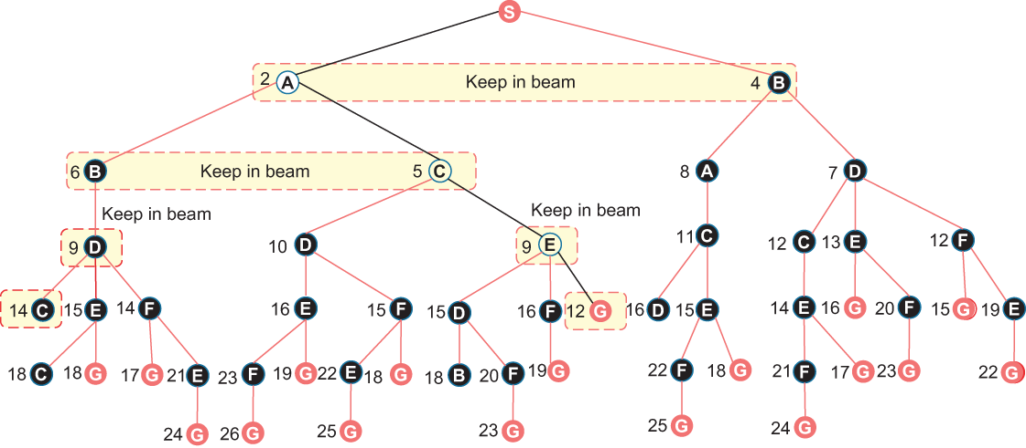
Shortest Path Algorithms
Beam Search

Slide 26
Shortest Path Algorithms
A* Algorithm
Pronounced “A-Star”; heuristic algorithm for computing the shortest path from one given start node to one given goal node.
The A* search algorithm is a variant of dynamic programming (Dijkstra) that tries to reduce the total number of states explored by incorporating a heuristic estimate of the cost to get the goal from a given state.
Notes:
26

Slide 27
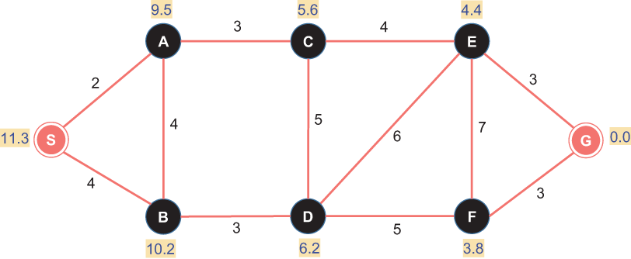

Shortest Path Algorithms
A* Algorithm: City-travelling Problem
$f(n)=g(n)+h(n),$where $g(n)$ is the actual cost of the partial path already traveled from the source node $S$ to node $n$ and $h(n)$ is heuristic information.
Notes:
27

Slide 28
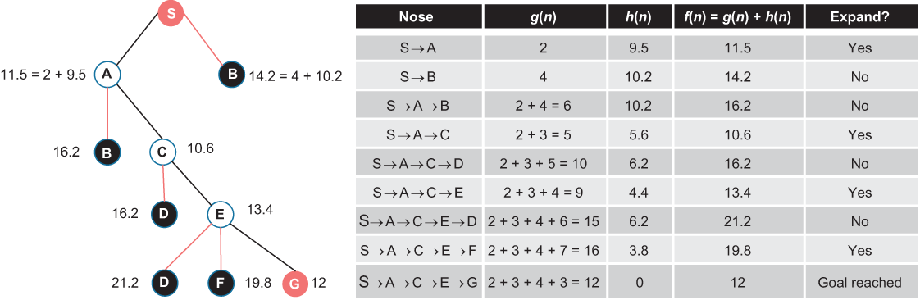
Shortest Path Algorithms
A* Algorithm: City-travelling Problem
Notes:
28

Slide 29
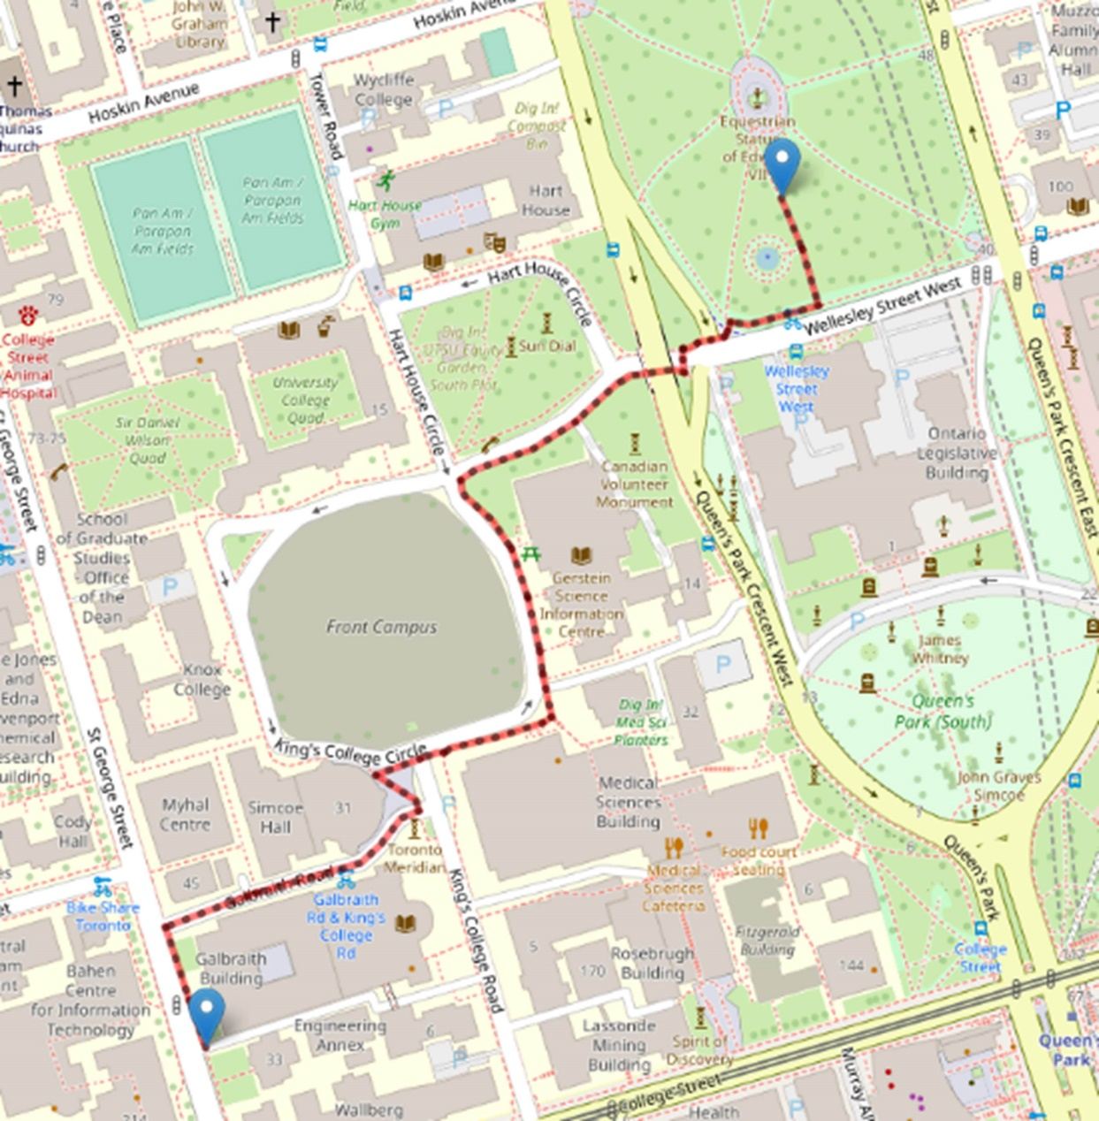
Shortest Path Algorithms
A* Algorithm: UofT Routing Problem
source_point = (43.664527, -79.392442)
# King Edward VII Equestrian Statue
destination_point = (43.659659, -79.397669)
# Bahen Centre for Information Technology at UofT
Check: https://github.com/Optimization-Algorithms-Book/Code-Listings/blob/main/Chapter%203/Listing%203.11_comparison.ipynb
Notes:
29

Slide 30
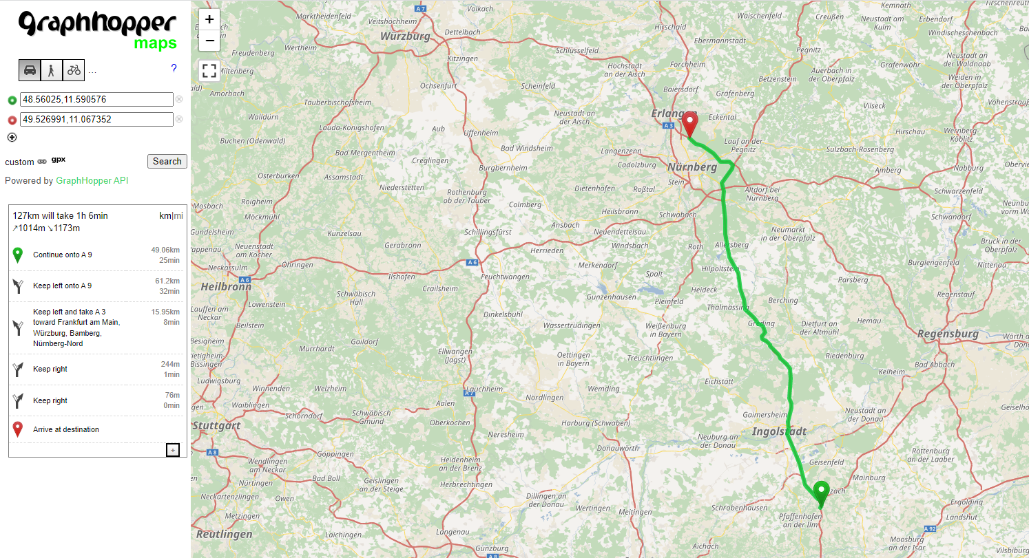
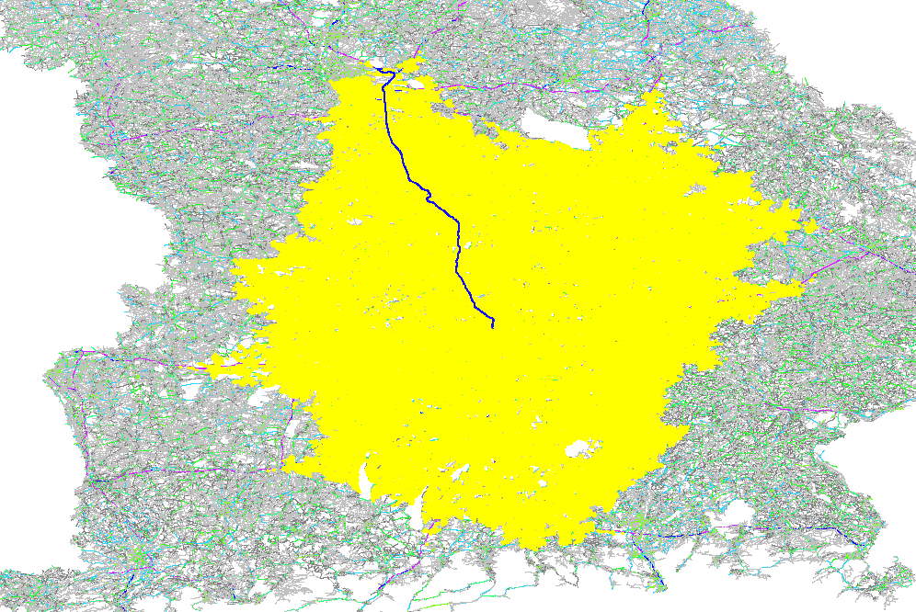
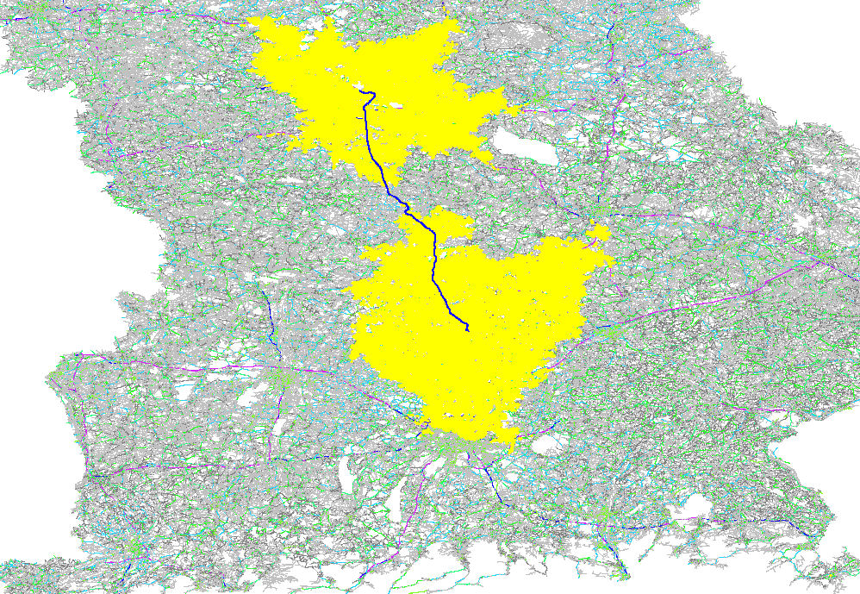

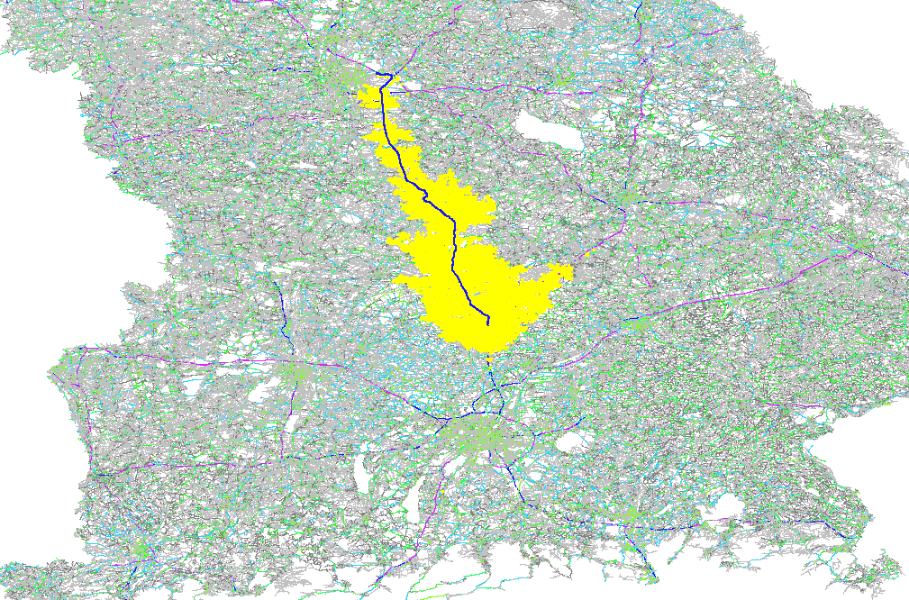
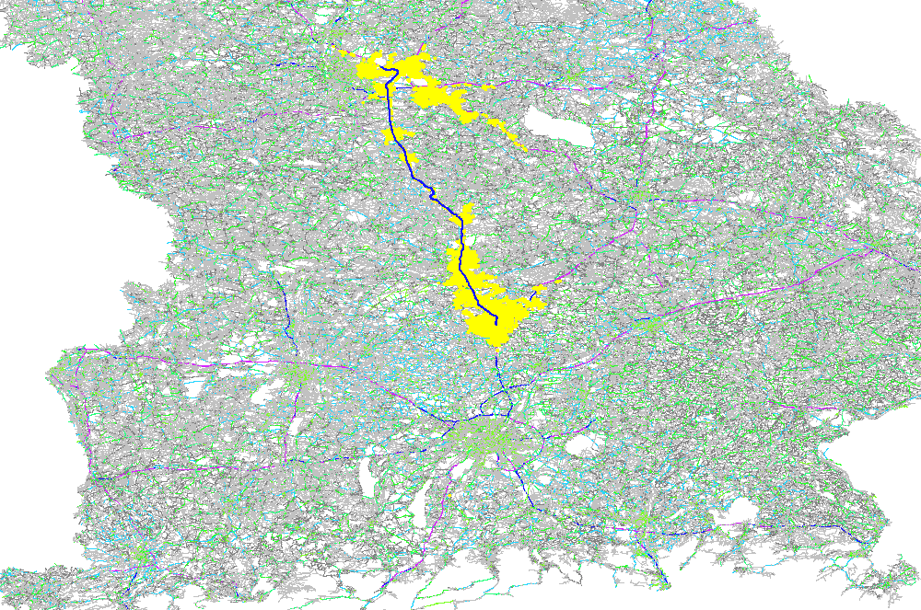
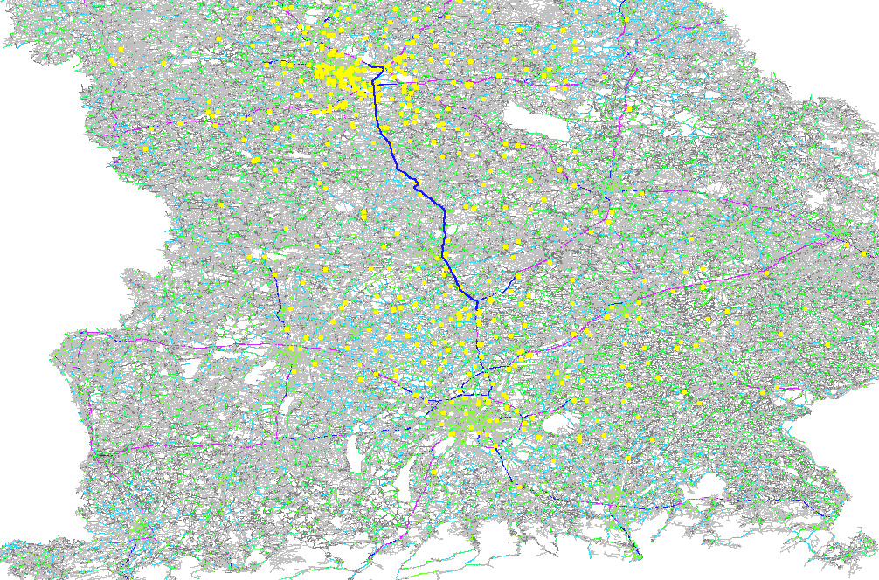
Shortest Path Algorithms
Contraction Hierarchies (CH)
For reading only: Section 4.3.4 in the textbook
~130km example route
Unidirectional Dijkstra with 500K visited nodes
Bidirectional Dijkstra with 220K visited nodes
Unidirectional A* with 50K visited nodes
Bidirectional A* with ~25K visited nodes
Contraction Hierarchies with ~600 visited nodes
Notes:
30

Slide 31
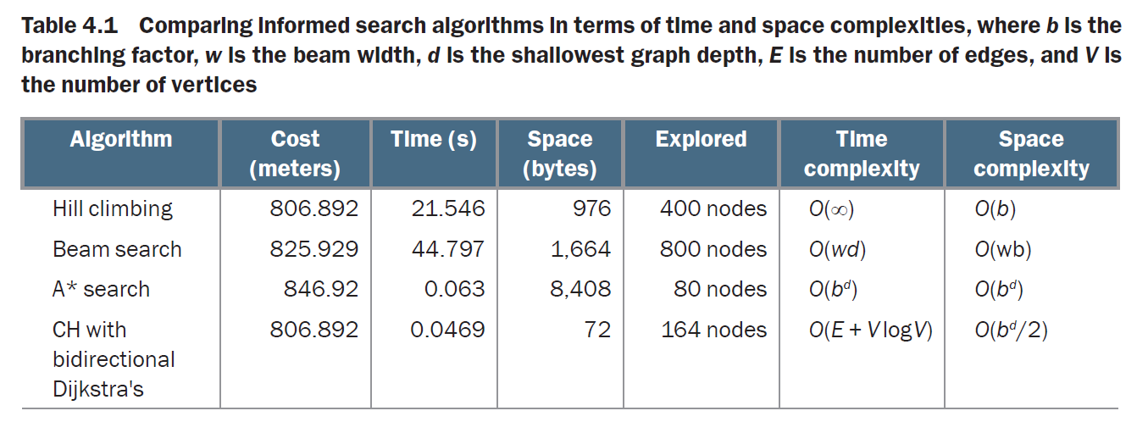
Shortest Path Algorithms
Comparison
For reading only: Section 4.3.4 in the textbook
Notes:
31

